Slide 1
Campus Eats Database ER Modeling Group 17
Mohammadali Fallahian
Abhilash Mandlekar
Dayakar Ravuri

Slide 2
Rating Models Implementation

Slide 3
Rating Models Implementation Business rules
Each user can rate order, driver and restaurant.
Each order can have many rating.
Each order can have one driver rating.
Each order can have one restaurant rating.
Each driver can have many rating.
Each restaurant can have many rating.
In driver and restaurant rating we want to know which person on which order rate the driver or restaurant.

Slide 4
Rating Models Implementation Entities and Relationships
ratings table: It stores overall rating about orders
column | type | Indexes & Relationship
rating_id | int | Primary key, auto increment
order_id | int | Foreign key, to order table
overall_rating | int
restaurant_ratings table: It stores rating about restaurants.
column | type | Indexes & Relationship
rating_id | int | Primary key, auto increment
restaurant_id | int | Foreign key, to restaurant table
food_rating | int
price_rating | int
order_id | int | Foreign key, to order table

Slide 5
Rating Models Implementation Entities and Relationships
driver_ratings table: It stores rating about drivers
column | type | Indexes & Relationship
rating_id | int | Primary key, auto increment
driver_id | int | Foreign key, to driver table
ontime_rating | int
courteous_rating | int
order_id | int | Foreign key, to order table

Slide 6
Rating Models Implementation Cardinalities
order to rating: One-To-Many
driver to driver_ratings: One-To-Many
restaurant to restaurant_ratings: One-To-Many
order to restaurant_ratings: One-To-One
order to driver _ratings: One-To-One

Slide 7
Create Table Scripts

Slide 8
Rating Models Implementation Queries
CREATE TABLE `ratings` (
`rating_id` int(11) NOT NULL AUTO_INCREMENT,
`overall_rating` int(11) NOT NULL,
`order_id` int(11) NOT NULL,
PRIMARY KEY (`rating_id`),
KEY `FK_rating_order_idx` (`order_id`),
CONSTRAINT `FK_rating_order` FOREIGN KEY (`order_id`) REFERENCES `orders` (`order_id`) ON DELETE NO ACTION ON UPDATE NO ACTION);

Slide 9
Rating Models Implementation Queries
CREATE TABLE `driver_rating` (
`rating_id` int(11) NOT NULL AUTO_INCREMENT,
`ontime_rating` int(11) NOT NULL,
`courteous_rating` int(11) NOT NULL,
`driver_id` int(11) NOT NULL,
`order_id` int(11) NOT NULL,
PRIMARY KEY (`rating_id`),
KEY `PK_driver_rating_driver_idx` (`driver_id`),
KEY `FK_driver_rating_order_idx` (`order_id`),
CONSTRAINT `FK_driver_rating_driver` FOREIGN KEY (`driver_id`) REFERENCES `driver` (`driver_id`) ON DELETE NO ACTION ON UPDATE NO ACTION,
CONSTRAINT `FK_driver_rating_order` FOREIGN KEY (`order_id`) REFERENCES `orders` (`order_id`) ON DELETE NO ACTION ON UPDATE NO ACTION);

Slide 10
Rating Models Implementation Queries
CREATE TABLE `restaurant_rating` (
`rating_id` int(11) NOT NULL AUTO_INCREMENT,
`food_rating` int(11) NOT NULL,
`price_rating` int(11) NOT NULL,
`restaurant_id` int(11) NOT NULL,
`order_id` int(11) NOT NULL,
PRIMARY KEY (`rating_id`),
KEY `PK_restaurant_rating_restaurant_idx` (`restaurant_id`),
KEY `FK_restaurant_rating_order_idx` (`order_id`),
CONSTRAINT `FK_restaurant_rating_order` FOREIGN KEY (`order_id`) REFERENCES `orders` (`order_id`) ON DELETE NO ACTION ON UPDATE NO ACTION,
CONSTRAINT `FK_restaurant_rating_restaurant` FOREIGN KEY (`restaurant_id`) REFERENCES `restaurant` (`restaurant_id`) ON DELETE NO ACTION ON UPDATE NO ACTION);

Slide 11
Test Data

Slide 12
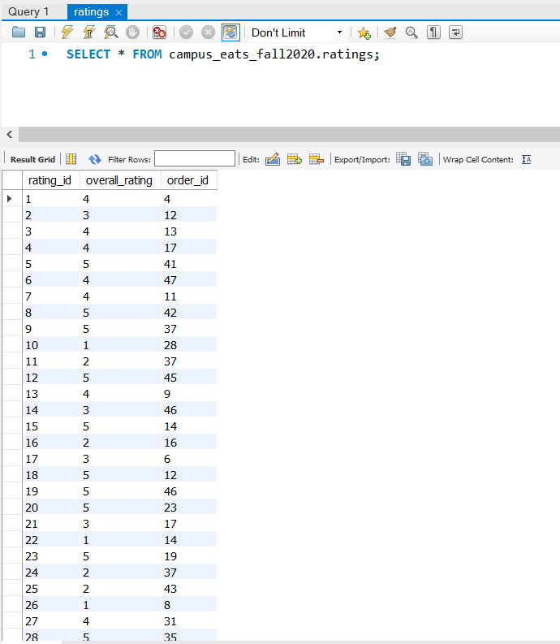
Adding Test Data ratings table

Slide 13
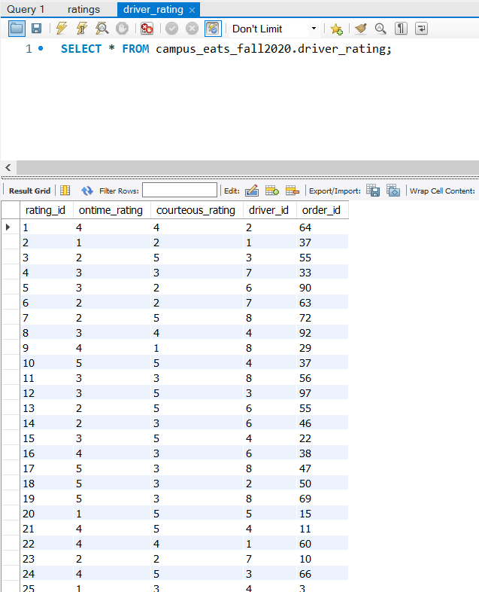
Adding Test Data driver_ratings table

Slide 14
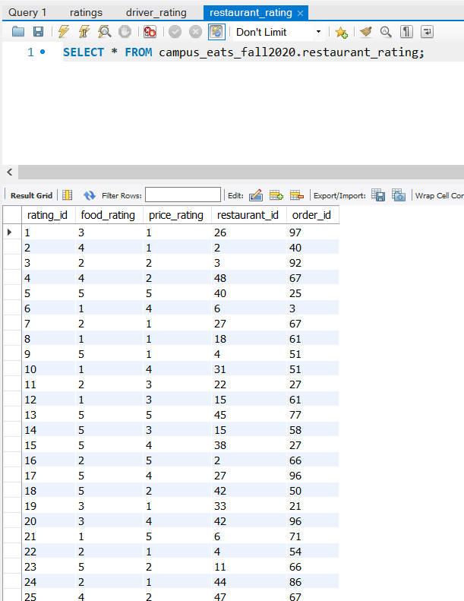
Adding Test Data restaurant_ratings table

Slide 15
Advanced View

Slide 16
Advanced View
person_rating view: In this view you can find list of all people whether rated or not and the aggerated average of ratings of price_rating, food_rating, courteous_rating, and ontime_rating for each person.
order_person_rating view: In this view you can find list of all order with the name of people ordered the food, delivery address and time and submitted rating by the person.
driver_person_rating view: In this view you can find list of all student who is working as driver with the average rating received from customers.

Slide 17
person_rating
Create view person_rating as
select p.person_name,
p.cell,
(case
when f.faculty_id is not null then 'Faculty'
when st.student_id is not null then 'Student'
when s.staff_id is not null then 'Staff'
else 'Other'
end) as person_kind,
ifnull((case
when f.faculty_id is not null then concat(f.title,' - ',f.highest_degree,' degree from ', f.degree_college)
when st.student_id is not null then concat(f.title,' - ',st.type,' of ', st.major)
when s.staff_id is not null then s.position
else 'Not Defined'
end),'Whitout Title') as title,
ifnull(price_rating, 'No Rate') as price_rating,ifnull(food_rating, 'No Rate') as food_rating,
ifnull(courteous_rating, 'No Rate') as courteous_rating,ifnull(ontime_rating, 'No Rate') as ontime_rating
from person as p left join
faculty as f on f.person_id=p.person_id left join
student as st on st.person_id=p.person_id left join
staff as s on s.person_id=p.person_id left join
(
select o.person_id, round(avg(rr.price_rating),2) as price_rating,
round(avg(rr.food_rating),2) as food_rating,
round(avg(dr.courteous_rating),2) as courteous_rating,
round(avg(dr.ontime_rating),2) as ontime_rating
from orders as o left join
restaurant_rating rr on rr.order_id=o.order_id left join
driver_rating dr on dr.order_id=o.order_id
group by o.person_id) as rate on rate.person_id=p.person_id;

Slide 18
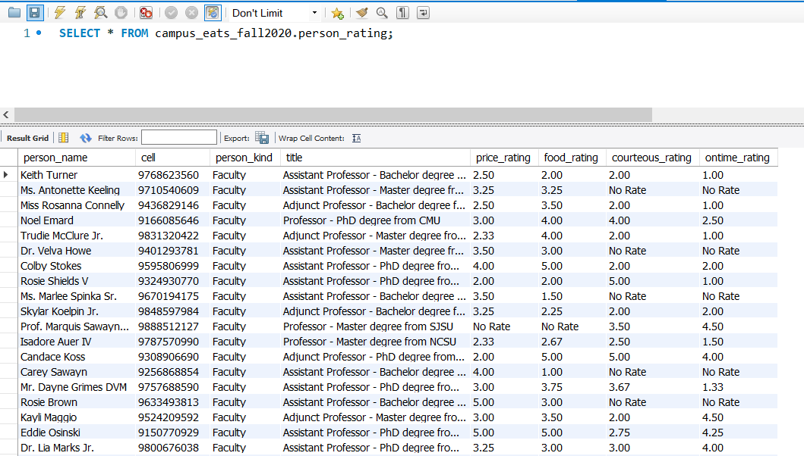
person_rating

Slide 19
order_person_rating
Create view order_person_rating as
SELECT o.order_id, p.person_name, l.location_address, DATE_FORMAT(d.delivery_time, "%W %M %e %Y") as delivery_date,
cast(d.delivery_time as time) as delivery_time, ifnull(r.overall_rating , 'No Rate') as overall_rating
FROM orders as o inner join
person as p on p.person_id=o.person_id left join
location as l on l.location_id=o.location_id left join
(select order_id, round(avg(overall_rating),2) as overall_rating
from ratings group by order_id) as r on r.order_id=o.order_id left join
delivery d on d.delivery_id=o.delivery_id;

Slide 20
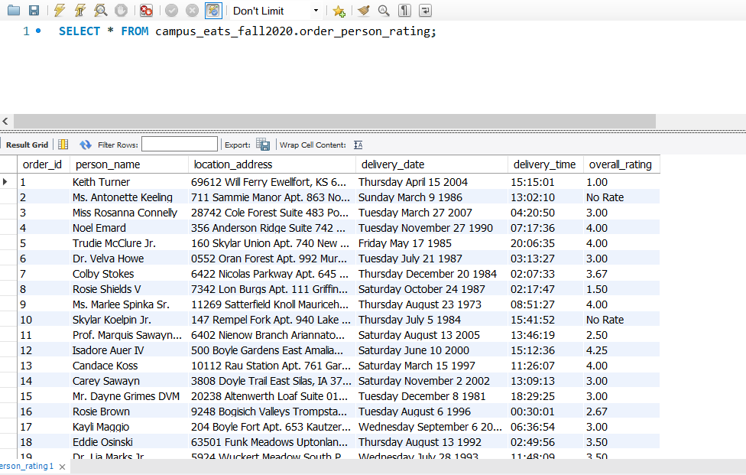
order_person_rating

Slide 21
driver_person_rating
Create view driver_person_rating as
select p.person_name,d.driver_id, d.license_number,
no_rate as number_of_rate, ontime_rating, courteous_rating
from driver d left join
student s on s.student_id=d.student_id left join
person p on p.person_id=s.person_id left join
(select driver_id, count(*) as no_rate, round(avg(ontime_rating),2) as ontime_rating,
round(avg(courteous_rating),2) as courteous_rating
from driver_rating
group by driver_id) as r on r.driver_id=d.driver_id

Slide 22
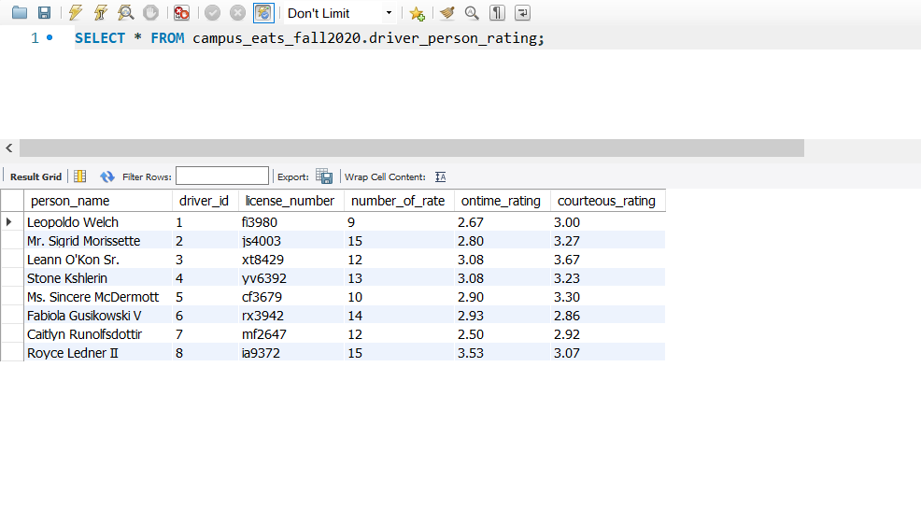
driver_person_rating

Slide 23
Corrections and Improvements

Slide 24
Add a field to show if a restaurant is approved or not
ALTER TABLE `restaurant`
ADD COLUMN `is_approved` TINYINT NOT NULL DEFAULT 1;
Add ‘foods’ table to collect information about nutrition of foods
CREATE TABLE `foods` (
`food_id` INT NOT NULL AUTO_INCREMENT,
`food_name` VARCHAR(200) NOT NULL,
`food_calorie` INT NULL,
`food_fat` INT NULL,
`food_price` FLOAT NOT NULL,
PRIMARY KEY (`food_id`));
Add ‘food_order’ table to store the foods of orders.
CREATE TABLE `food_order` (
`order_id` INT NOT NULL,
`food_id` INT NOT NULL,
PRIMARY KEY (`order_id`, `food_id`),
KEY `Fk_food_food_order_idx` (`food_id`),
KEY `Fk_order_food_order_idx` (`order_id`),
CONSTRAINT `Fk_food_food_order` FOREIGN KEY (`food_id`) REFERENCES `foods` (`food_id`) ON DELETE NO ACTION ON UPDATE NO ACTION,
CONSTRAINT `Fk_order_food_order` FOREIGN KEY (`order_id`) REFERENCES `orders` (`order_id`) ON DELETE NO ACTION ON UPDATE NO ACTION);

Slide 25
Remove driver_id from orders table because we have a foreign key on delivery_id and delivery table has driver id.
ALTER TABLE `orders`
DROP FOREIGN KEY `fk_O_driver_id`;
ALTER TABLE `orders`
DROP COLUMN `driver_id`,
DROP INDEX `fk_O_driver_id`;
Set a trigger on driver_rating table. When data is inserted it calculates the average of that driver and the rating field in driver table will be updated.
CREATE TRIGGER `driver_rating_AFTER_INSERT` AFTER INSERT ON `driver_rating` FOR EACH ROW
update driver set rating=(select avg((ontime_rating+courteous_rating)/2)
from driver_rating where driver_id=new.driver_id)
where driver_id=new.driver_id;

Slide 26
Create rating field in restaurant table for store average rating of restaurant.
ALTER TABLE `restaurant`
ADD COLUMN `rating` FLOAT NULL DEFAULT NULL;
Set a trigger on restaurant_rating table. When data is inserted it calculates the average of that restaurant and the rating field in restaurant table will be updated.
CREATE TRIGGER `restaurant_rating_AFTER_INSERT` AFTER INSERT ON `restaurant_rating` FOR EACH ROW
update restaurant set rating=(select avg((food_rating+price_rating)/2) from restaurant_rating where restaurant_id=new.restaurant_id)
where restaurant_id=new.restaurant_id;

Slide 27
Reverse Enginnering

Slide 28
